Slide 1
PHY151
Introduction

Slide 2
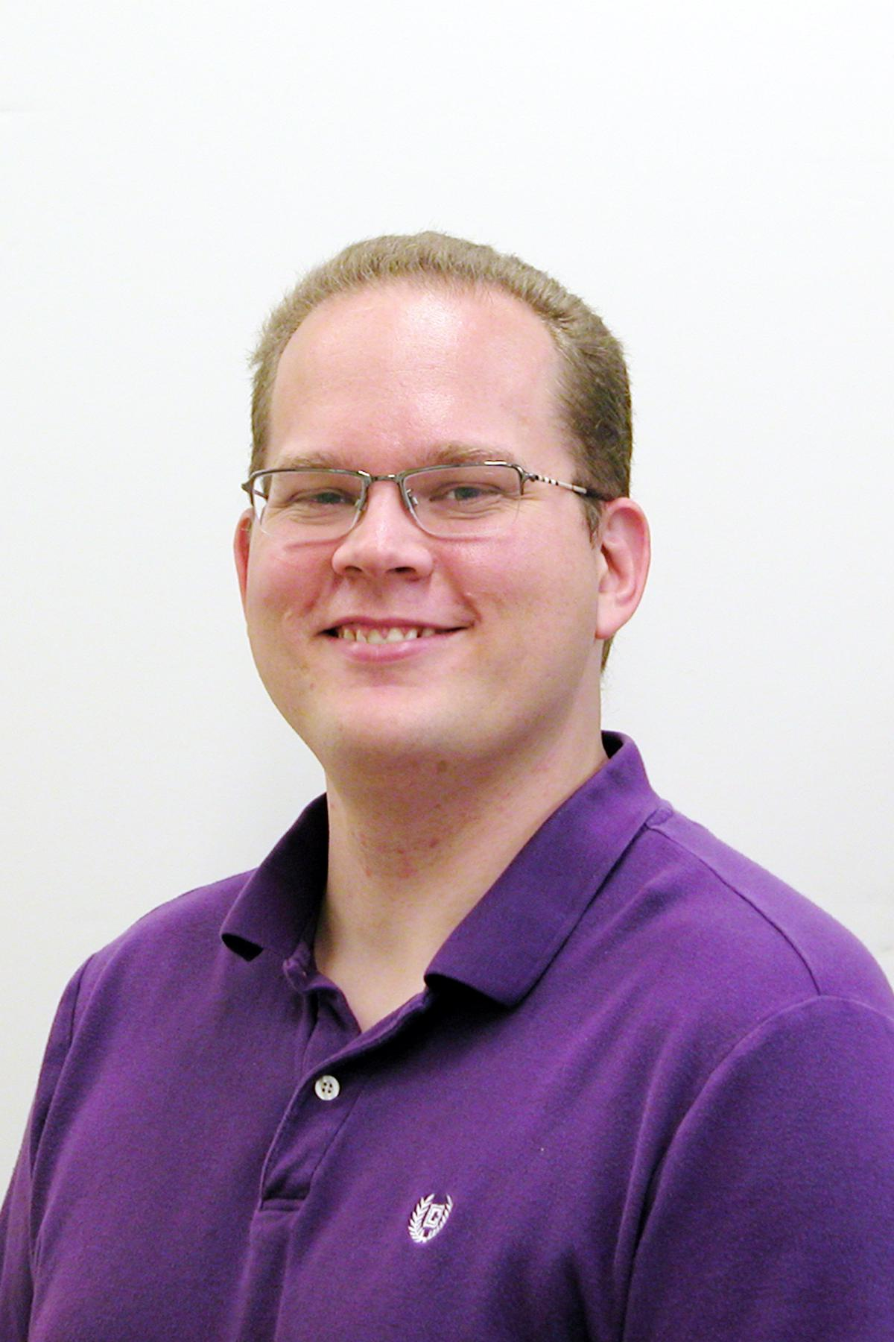
Who am I?
Prof. Brian Wilson (call me Brian)
Teaching Stream
Theorist (general relativity) who likes teaching labs now
Instructor for PHY151
brian.wilson@utoronto.ca

Slide 3
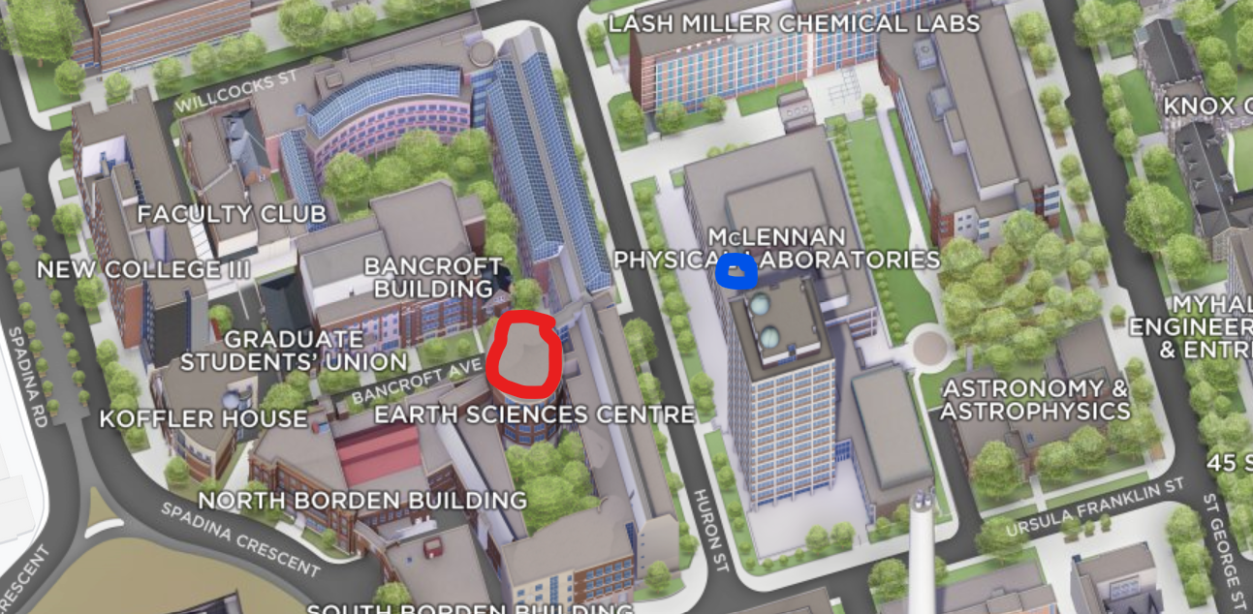
Where are the lectures and practicals?
Notes:
Click to add Notes

Slide 4
PHY131 vs. PHY151
Same conceptual content
PHY151 has a lot more calculus
Can do a physics major from either, but PHY151 is the preferred option (due to the calculus)
Classical mechanics and special relativity
Seems like a repeat of high school physics, but it’s not. We will go too fast for someone who has not done high school physics.

Slide 5
What should you know already?
Vectors & Cartesian coordinates
Derivatives
Kinematics (position/velocity/acceleration)
Newton’s laws
Energy, momentum
Maybe: rotations, torque, angular momentum, centre of mass, orbital mechanics
New: special relativity

Slide 6
What do you need?
Scientific, non-graphing calculator (under $40)
Computer and internet access (Quercus)
Mastering Physics (from the UofT bookstore!)
Physics for Scientists and Engineers (5th ed) by Knight (Mastering Physics should come with an electronic copy of the textbook)
Smartphone or tablet/laptop with wifi for classes
Nothing else (no lab coats or lab books)

